Slide 1


Slide 2
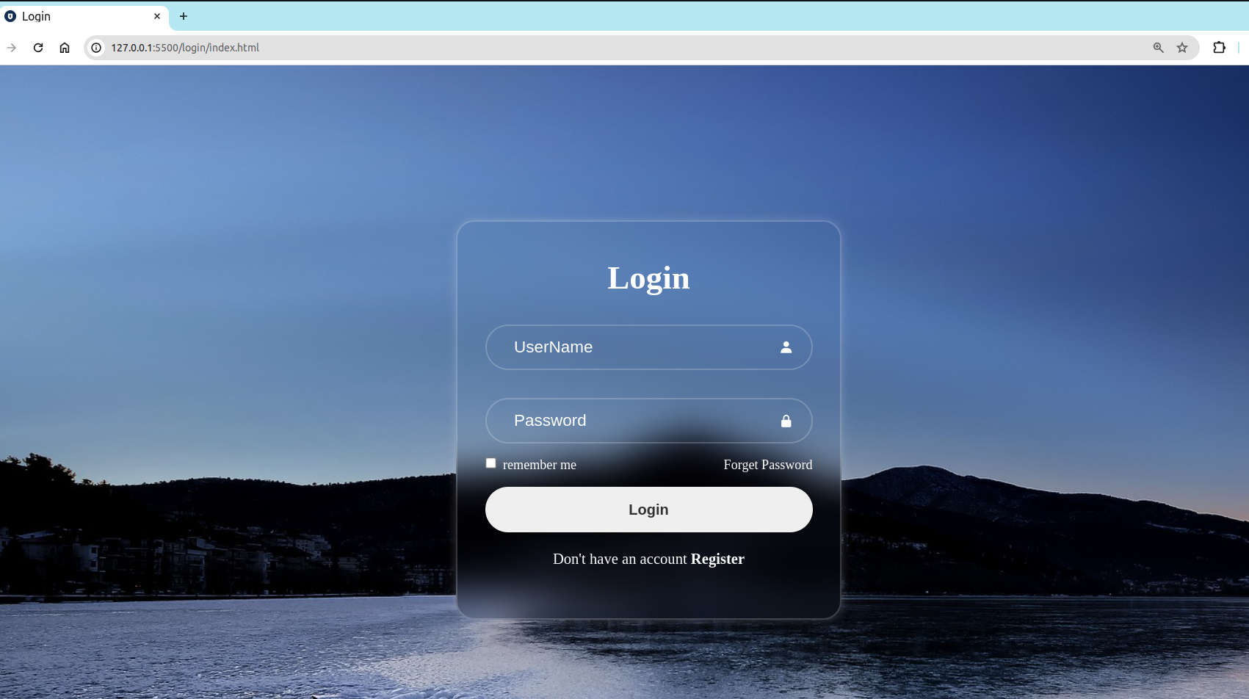
How could we use div to make a fancy login form

Slide 3
Let us start by adding some important meta tags
To specify the character encoding for the HTML document we use
<meta charset="utf-8">
to make the web-page work with old browsers we use
<meta http-equiv="X-UA-Compatible" content="IE-edge">
to make the web-page compatiable with all devices we use
<meta name="viewport" content="width=device-width, initial-scale=1.0">

Slide 4


To add icon for our page
<link rel="icon" type="image/x-icon" href="images/login.ico">
You can download whatever icons your want from this website
https://icon-icons.com/search/icons/login

Slide 5
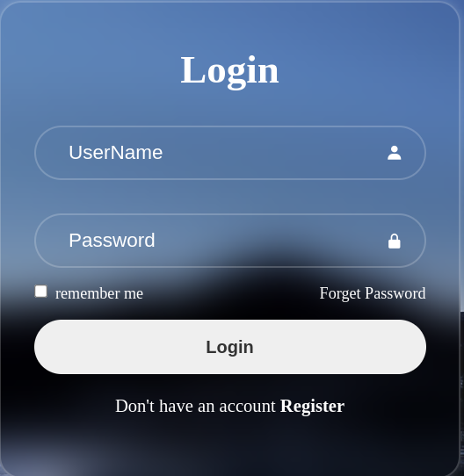
From this picture we can deduce we have
1- head tag
2- three input tags from the types ( text , password
Checkbox)
3- one button from the type (button)
4- two links[a tags] one for forget the password
,and the other for register
5- two icons one for UserName and the other for
password

Slide 6
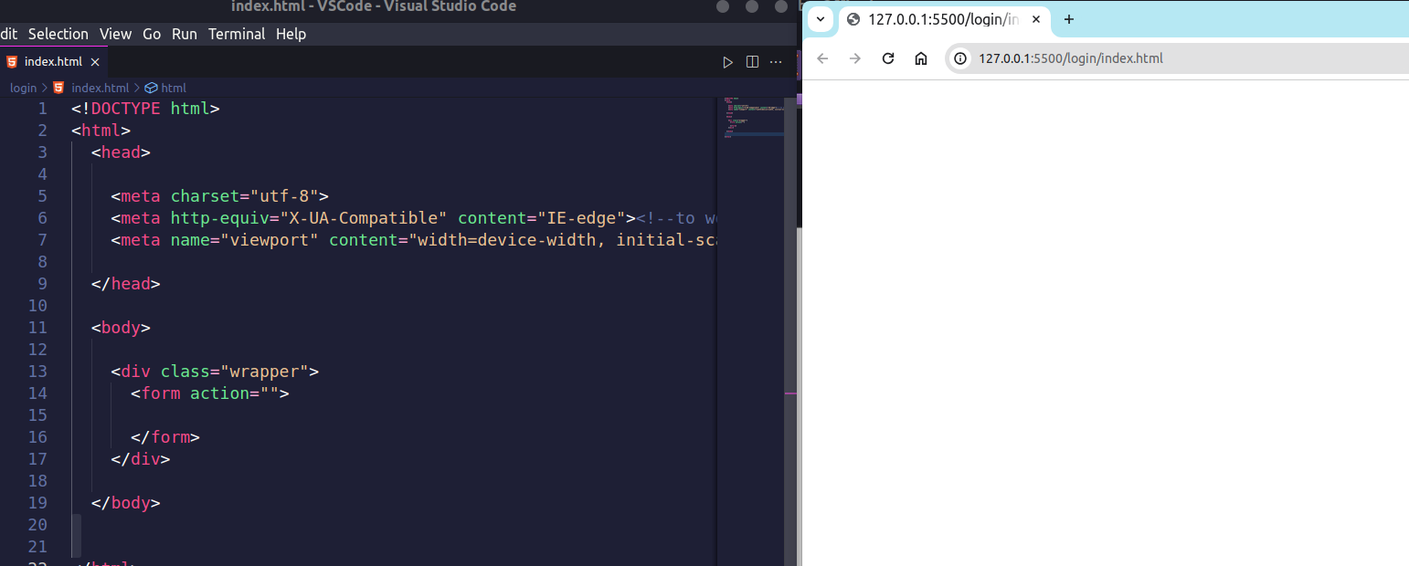
Let us start by grouping our content inside a div and name it “wrapper” to style the the overall elements ,and inside This div we add a form to control and collect the data of the overall elements ,we will let the the action attribute empty because we don’t want to send the data we collected to anywhere
<div class="wrapper">
<form action="">
</form>
</div>

Slide 7
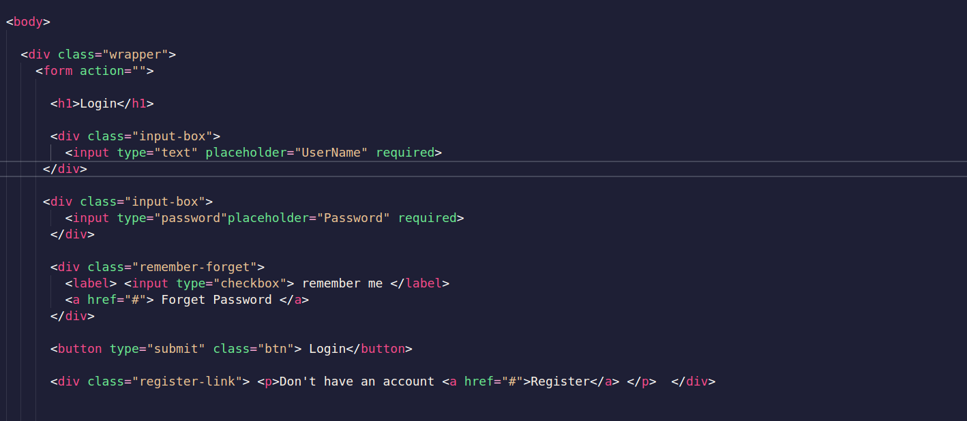

Slide 8
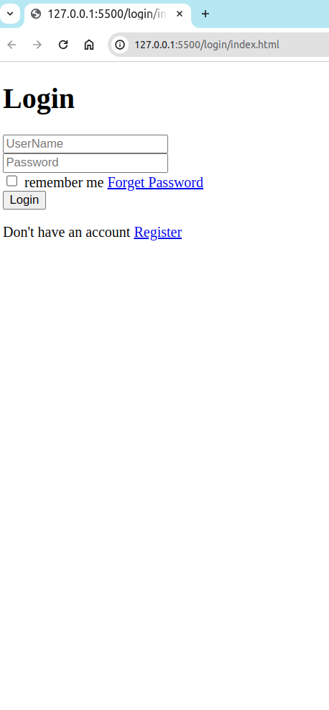
<h1>Login</h1>
<div class="input-box">
<input type="text" placeholder="UserName" required>
</div>
<div class="input-box">
<input type="password"placeholder="Password" required>
</div>
<div class="remember-forget">
<label> <input type="checkbox"> remember me </label>
<a href="#"> Forget Password </a>
</div>
<button type="submit" class="btn"> Login</button>
<div class="register-link"> <p>Don't have an account <a href="#">Register</a> </p> </div>
Be aware of the classes’ names because we are going to use it in the CSS

Slide 9
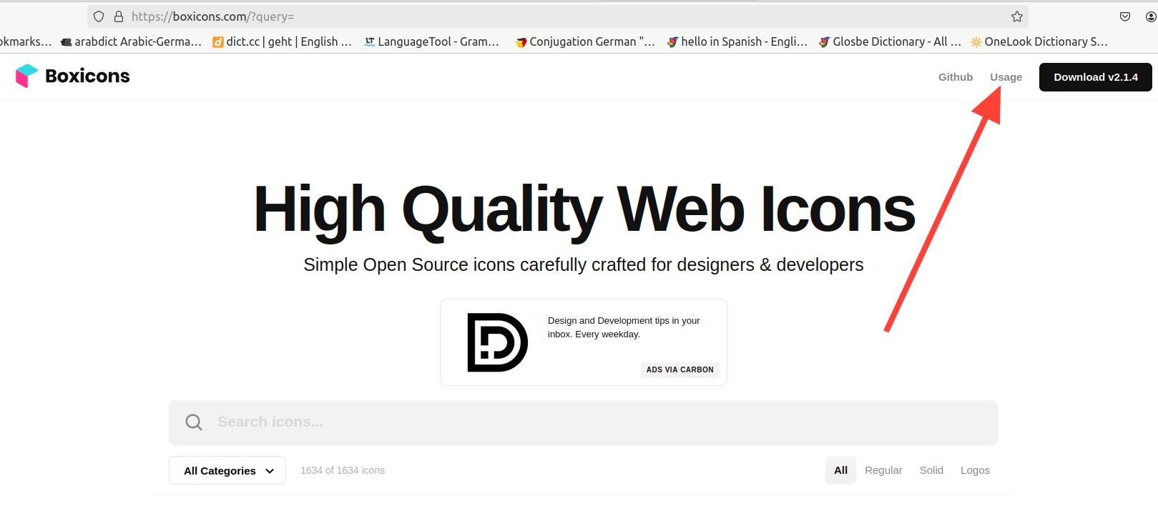
How could we add these icons to our html , I will bring it from this website
https://boxicons.com/
Steps
1-click at “Usage” in the top-right

Slide 10
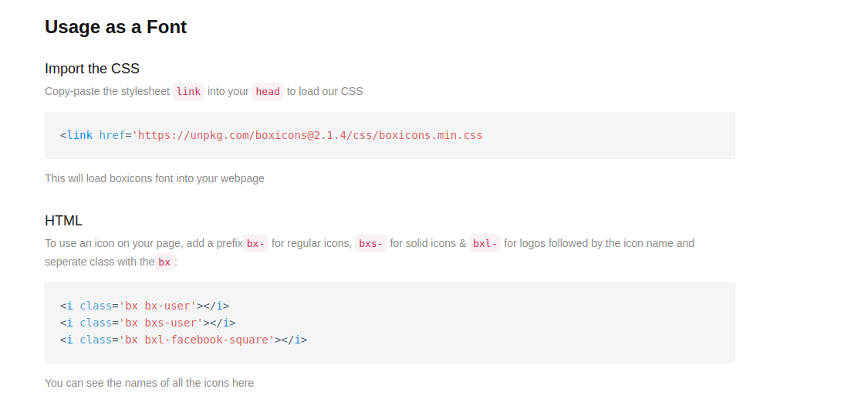
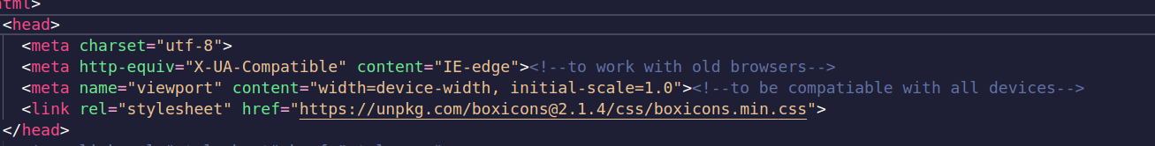
2-Scroll down to “Usage as Font”
3-Copy the stylesheet in “import the CSS” and put it in your html’s head section
4- read how to use it in your html

Slide 11
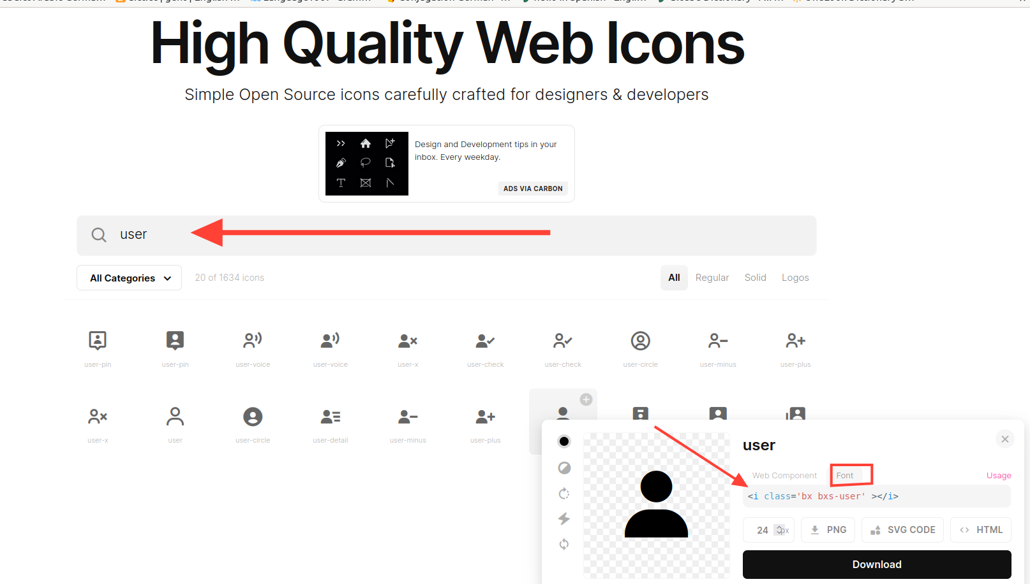
5- return back to https://boxicons.com/ and search for the icons ( I will use one for user and the other one for password)
6- copy <i class='bx bxs-user'></i> and paste it inside the user input-box class

Slide 12
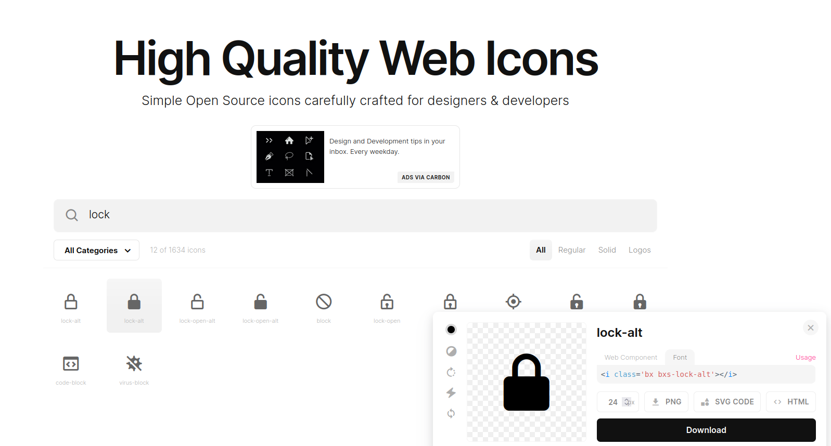
7- repeat the same thing for password input-box class

Slide 13
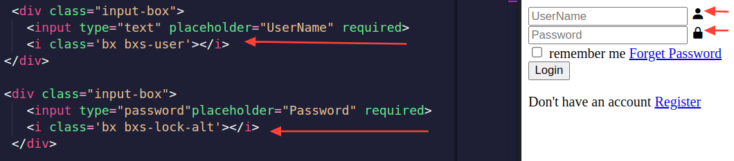
We put the two inputs into two different divs for the seek of more flexibility when we implement the CSS ,also with the same name to implement the CSS once for both of them

Slide 14
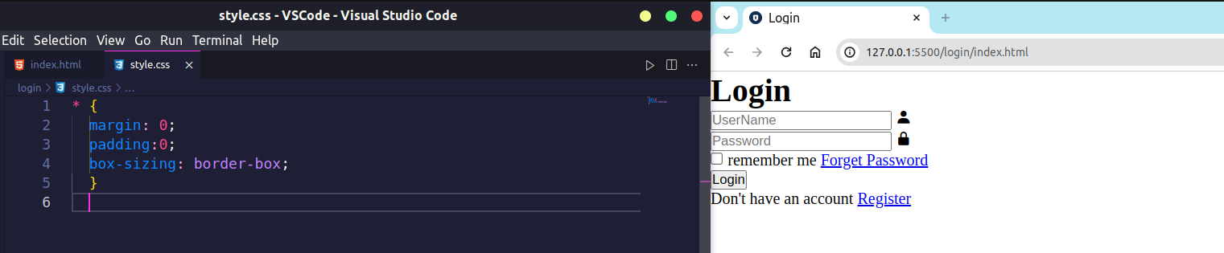
CSS
Let us make an external CSS to style our page <link rel="stylesheet" href="style.css">
Box-sizeing → Defines how the width and height of an element are calculated: should they include padding and borders, or not
To read more check
https://developer.mozilla.org/en-US/docs/Web/CSS/box-sizing
* {
margin: 0;
padding:0;
box-sizing: border-box;
}

Slide 15
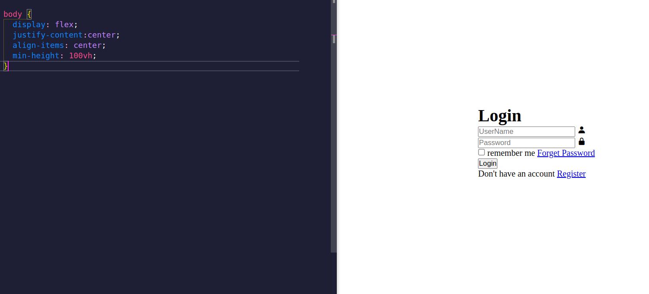
We use
display:flex
To split the page to main-axis and cross-axis
So we can control the main-axis with justify-content and the corss-axis with align-items
body {
display: flex;
justify-content:center;
align-items: center;
min-height: 100vh;
}
https://www.w3schools.com/css/css3_flexbox.asp
To know more about flex
https://www.youtube.com/watch?v=phWxA89Dy94

Slide 16
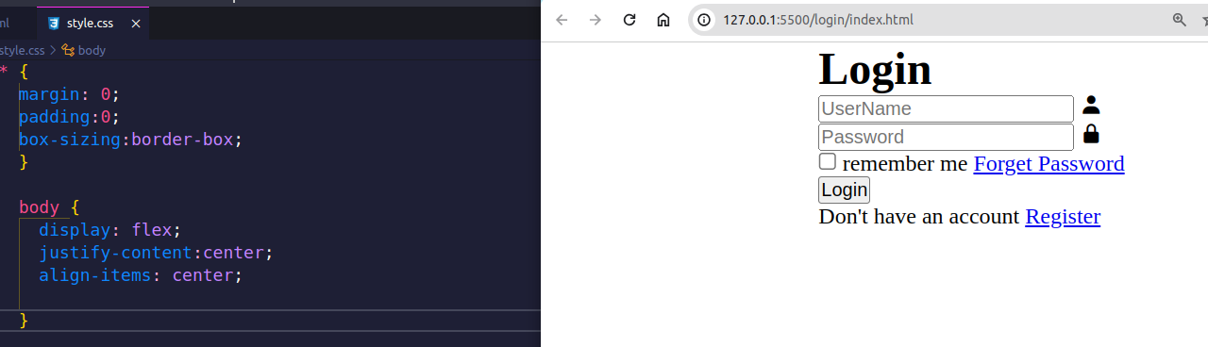
We put min-height=100vh because we want to take the entire height of the page even when
The user zoom-in or zoom-out [ vh → viewport height(the height of user’s device) ]
If we remove it the browser will
Be confused about the height of
The page in the cross-axis
Therefore align-items will not work

Slide 17
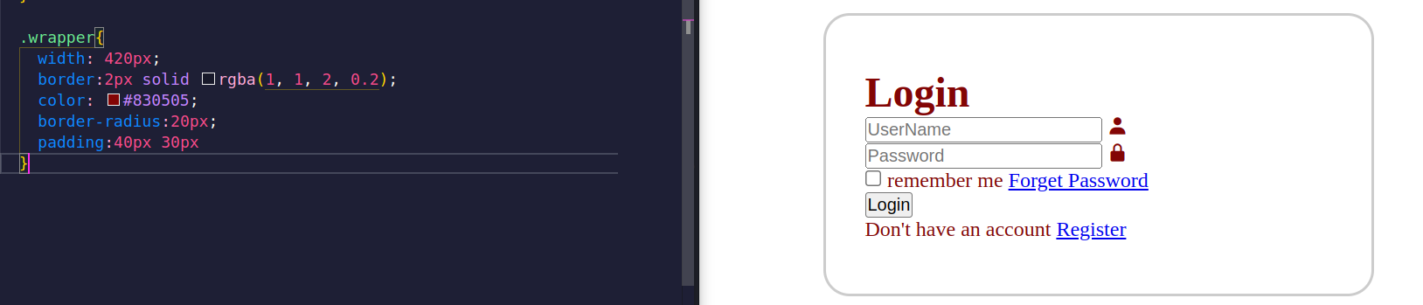
We made a width,color ,padding as well as border(we shaped it in a radius way)
assgin any color for now
.wrapper{
width: 420px;
border:2px solid rgba(1, 1, 2, 0.2);
color: #830505;
border-radius:20px;
padding:40px 30px
}
Notice: we declare rgba syntax as follows → rgba(red, green, blue, alpha)
alpha → Defines the opacity as a number between 0.0 (fully transparent) and 1.0 (fully opaque)

Slide 18
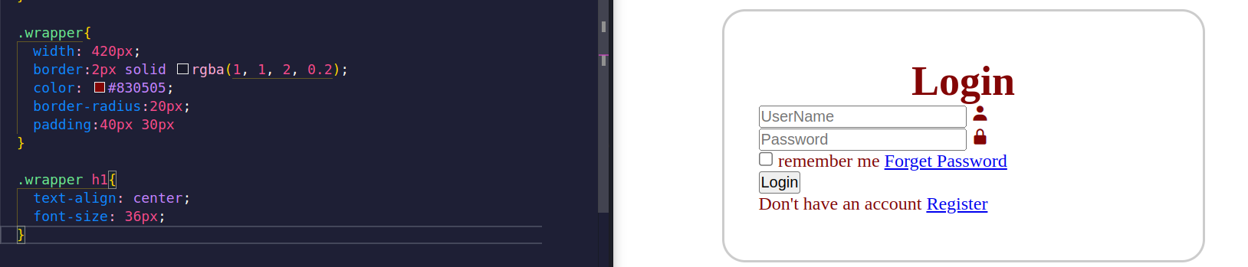
We now centered Login and changed its font size

Slide 19
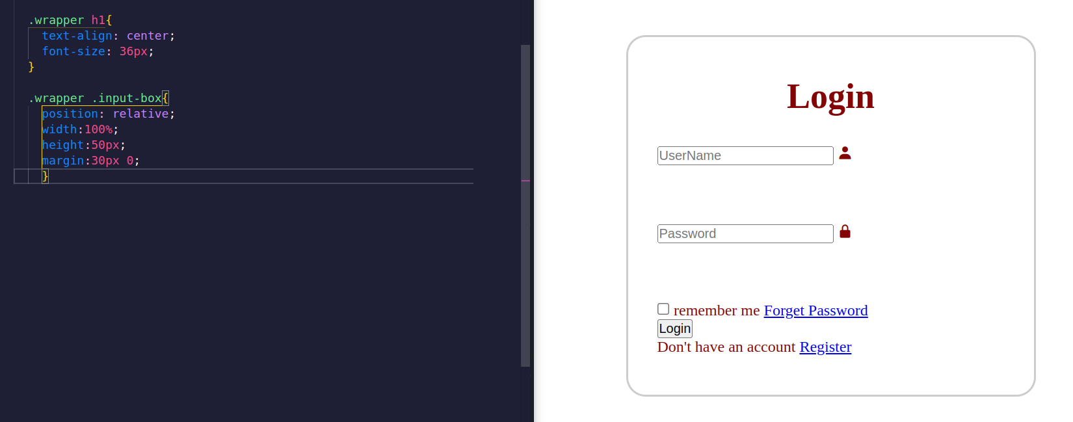
We here declare the width ,height , margin of the div container
Notice: we set the position:relative → to position it to its normal position we will know its benefit
later when we position the user & password icons
To read about position
https://www.w3schools.com/css/css_positioning.asp

Slide 20
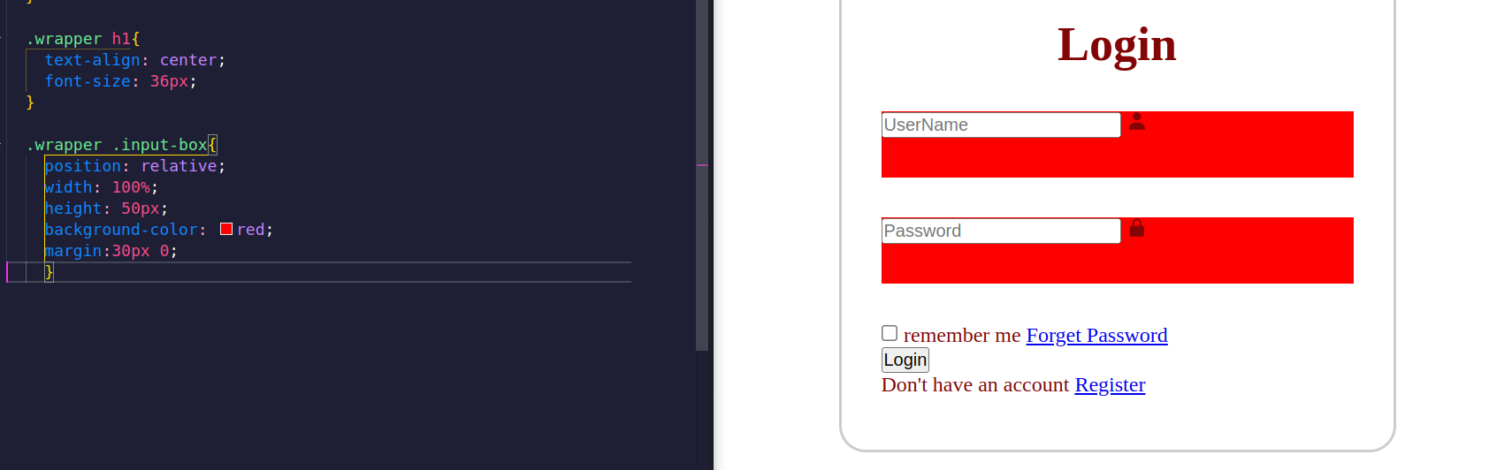
To imagine what we mean of setting a width and height to div we can add
background-color the width of class “input-box” is 100% and the height is
50px

Slide 21
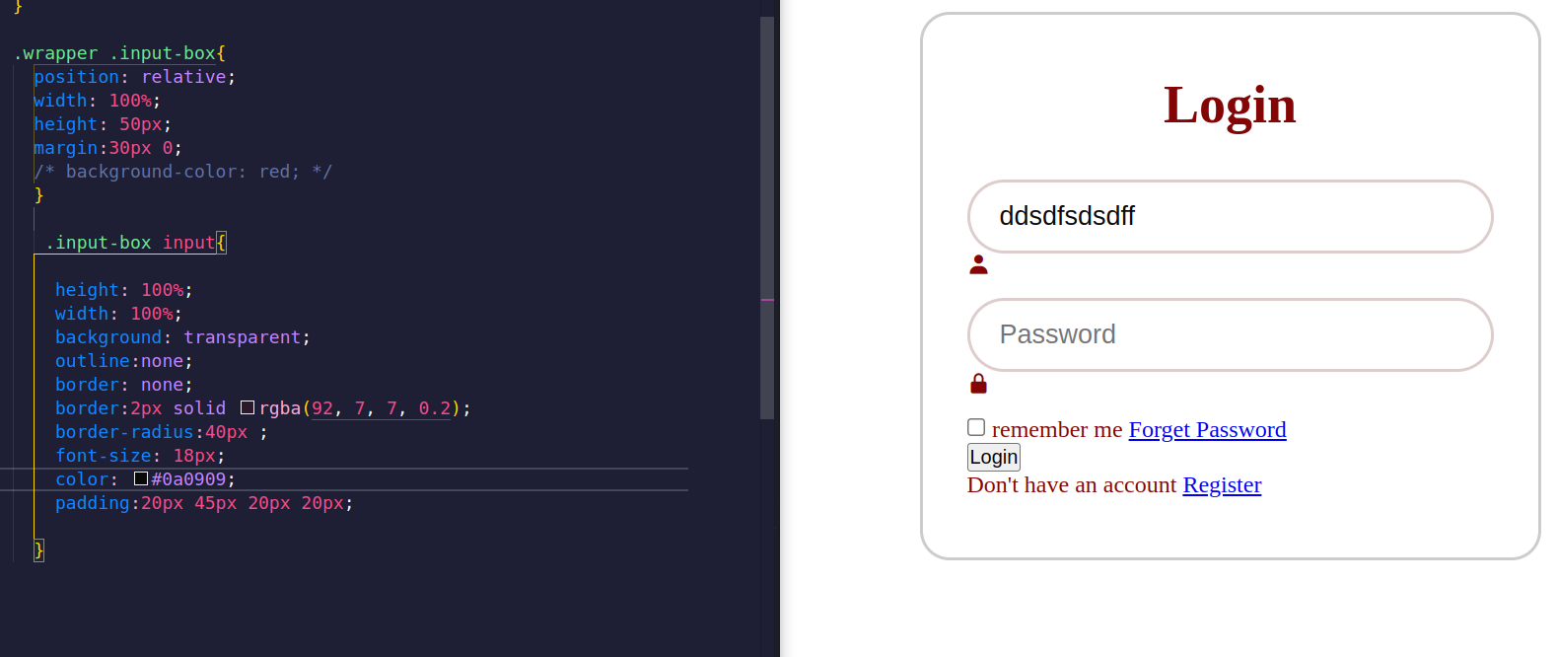
Let us change the style of input
We start by sitting width and height
For the input ,then we set the outline
And the border to none,we then
Redeclared the border(and set its shape to radious) And changed its text color and size ,we set a padding
And lastly we set the background color to transparent

Slide 22
.input-box input{
Height: 100%;
Width: 100%;
background: transparent; outline:none;
border: none;
border:2px solid rgba(92, 7, 7, 0.2);
border-radius:40px ;
font-size: 18px;
color: #0a0909;
padding:20px 45px 20px 20px;
}
To understand the the idea behind the background: transparent
Let us make let us set background-color to class “input-box”

Slide 23
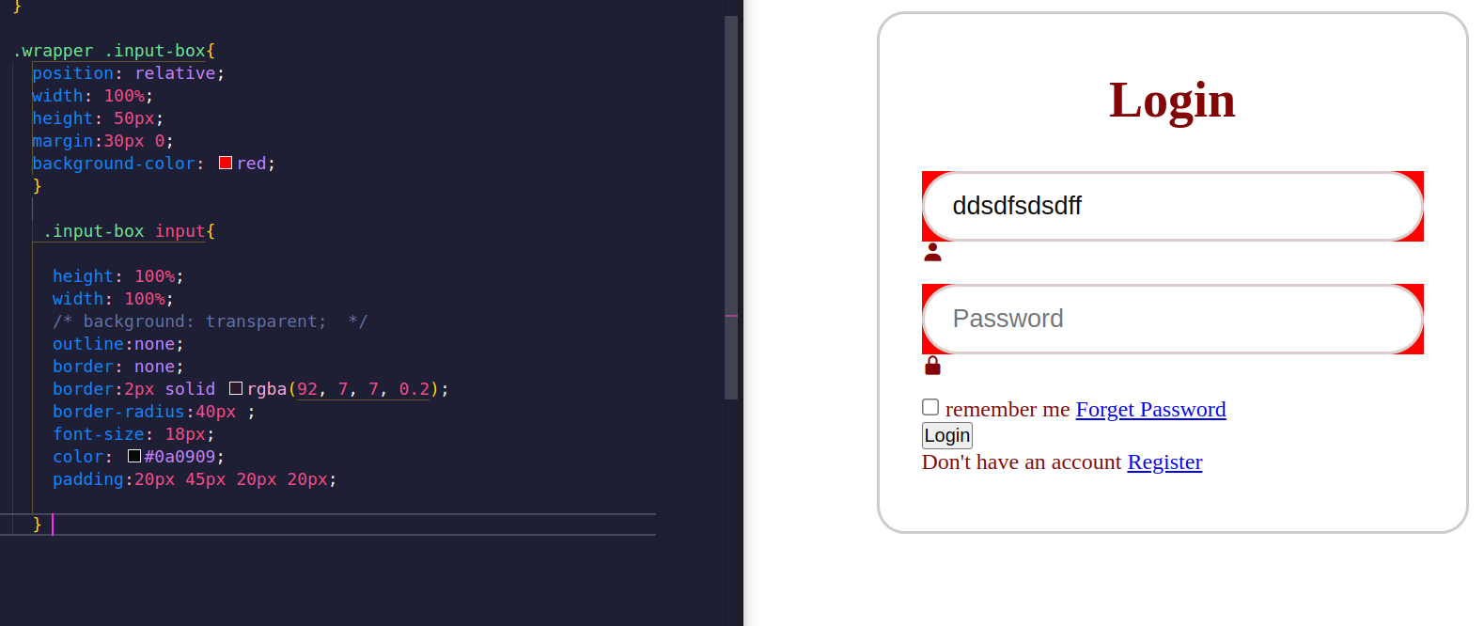
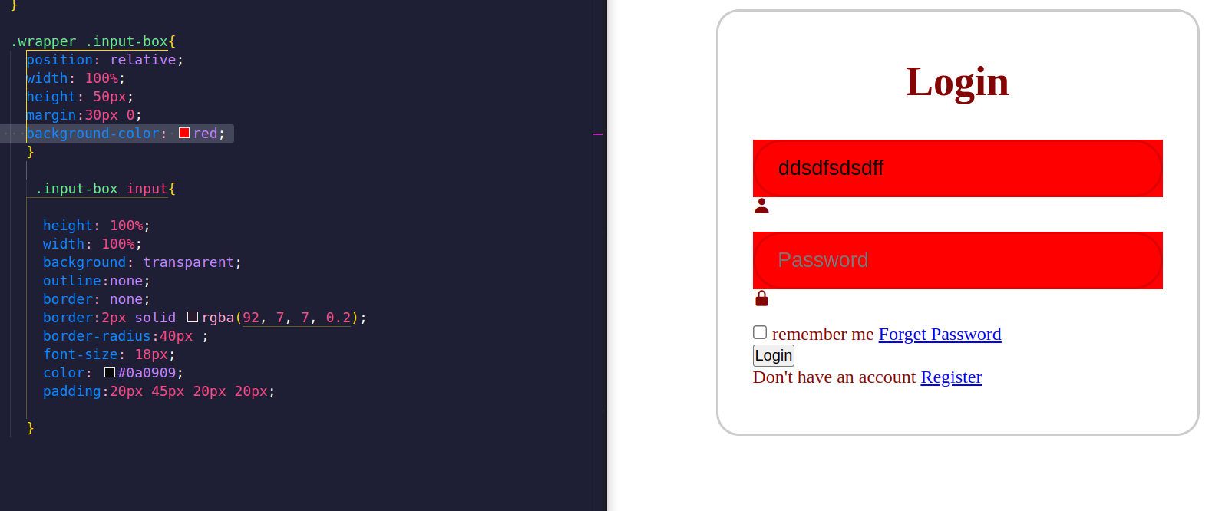

Slide 24
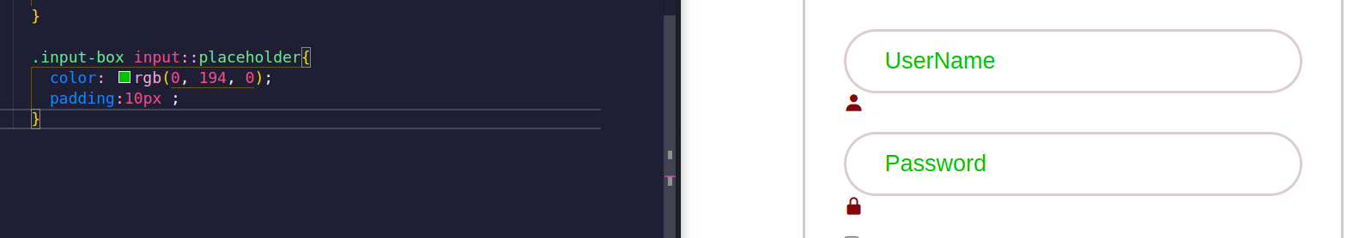
Let us now change the placeholder’s style of the two inputs
I will add a padding and color (choose whatever color for now)
.input-box input::placeholder{
color: rgb(0, 194, 0);
padding:10px ;
}

Slide 25
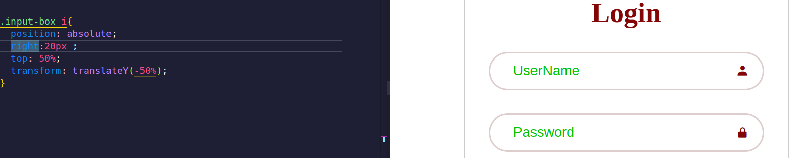
Let us change the icons of user & password
We started by setting the position:absolute so we can
Position it relative to the nearest positioned ancestor
The nearst positions ancestor here is “input-box” look at slide number 19 , we set the icons 20px far from the right and 50% far from the top
.input-box i{
position: absolute;
right:20px ;
top: 50%;
transform: translateY(-50%);
}

Slide 26
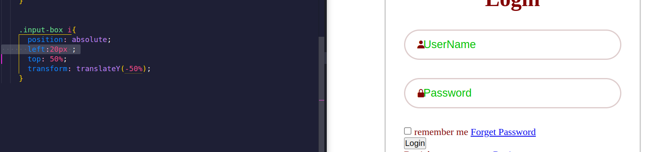
Take a look at the position of the icons when we change it to 20px from the left not the right
Transform property--> applies a 2D or 3D transformation to an element.

Slide 27
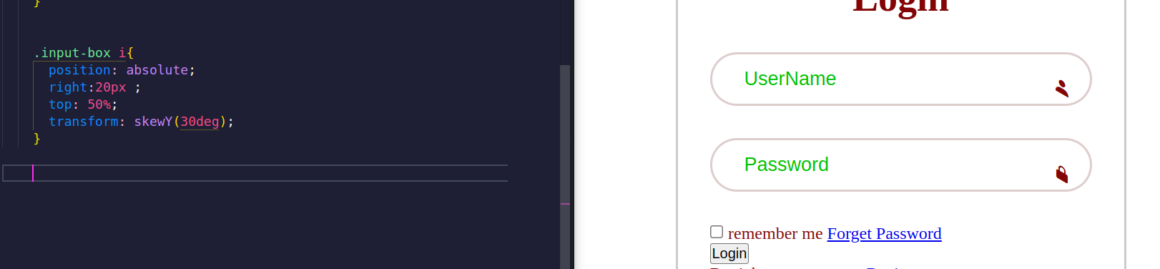
Let us try to
skewY(angle) : which defines a 2D skew transformation along the Y-axis
Look what has happened to the icons
To read more check about transform https://www.w3schools.com/cssref/css3_pr_transform.php

Slide 28
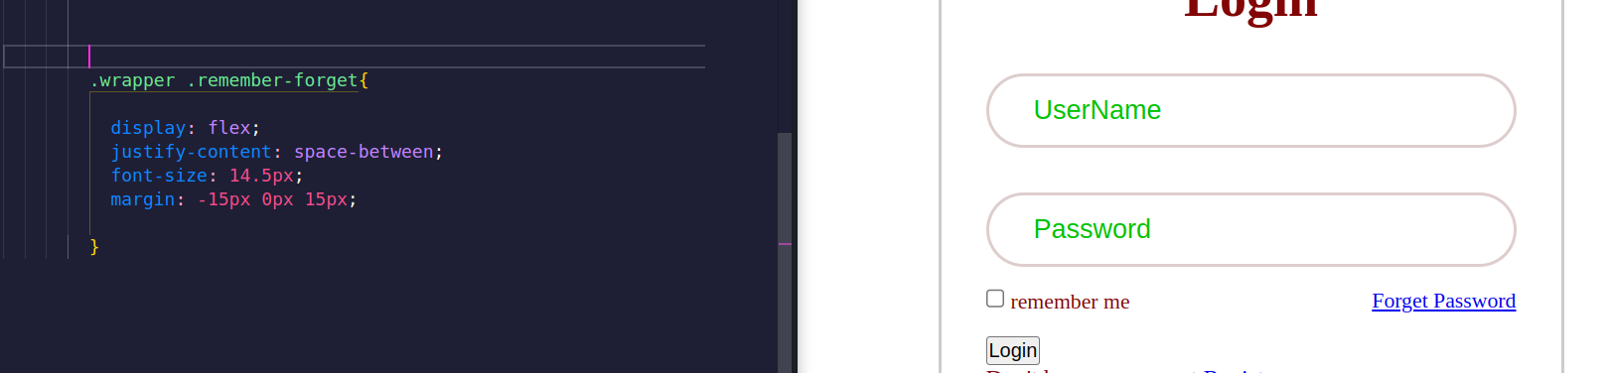
Let us change the style of the class “remember-forget “ by changing the display to flex so we
Can split the page then justify-content to space-between to put space between the
checkbox(remember me) and the link(forget password) , then setting font-size and margin
.wrapper .remember-forget{
display: flex;
justify-content: space-between;
font-size: 14.5px;
margin: -15px 0px 15px;
}

Slide 29


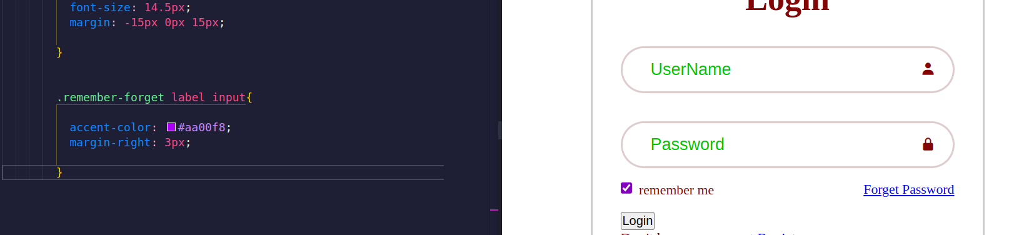
We now set margin-right and accent-color to the label and the input inside the
class “remembe-forget”
This is the result of accent-color when we click
It changs the color
.remember-forget label input{
accent-color: #aa00f8;
margin-right: 3px;
}

Slide 30
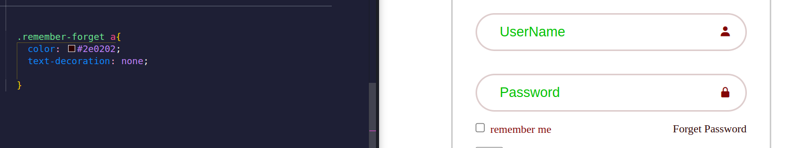
Let us remove the line under forget password and change its color
.remember-forget a{
color: #2e0202;
text-decoration: none;
}

Slide 31
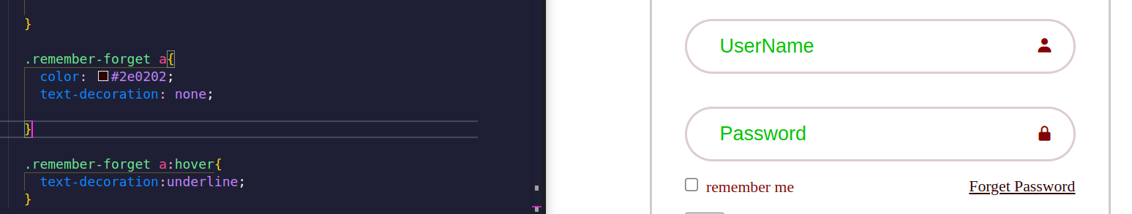
Now I will add the underline to link when anyone hovers over it
.remember-forget a:hover{
text-decoration:underline;
}

Slide 32
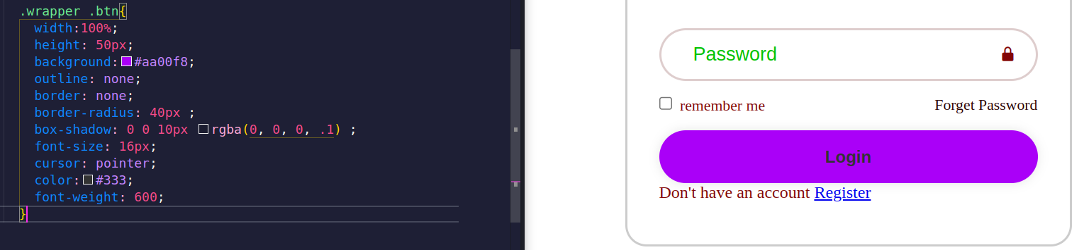
Let us change the style of the button
Notice box-shadow is the shadow of the button
To read more about box-shadow https://www.w3schools.com/cssref/css3_pr_box-shadow.php

Slide 33
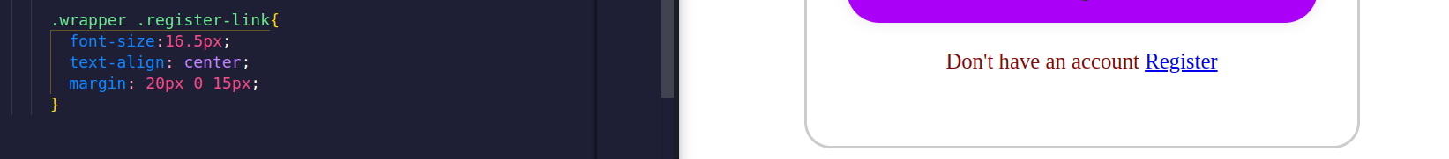
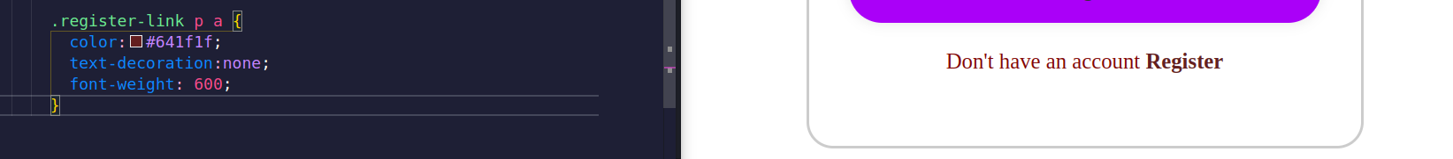
Now let us change the register-link
Let’s change the link tag inside the paragraph tag in “register-link” class
Adding under line when hovering over the link

Slide 34
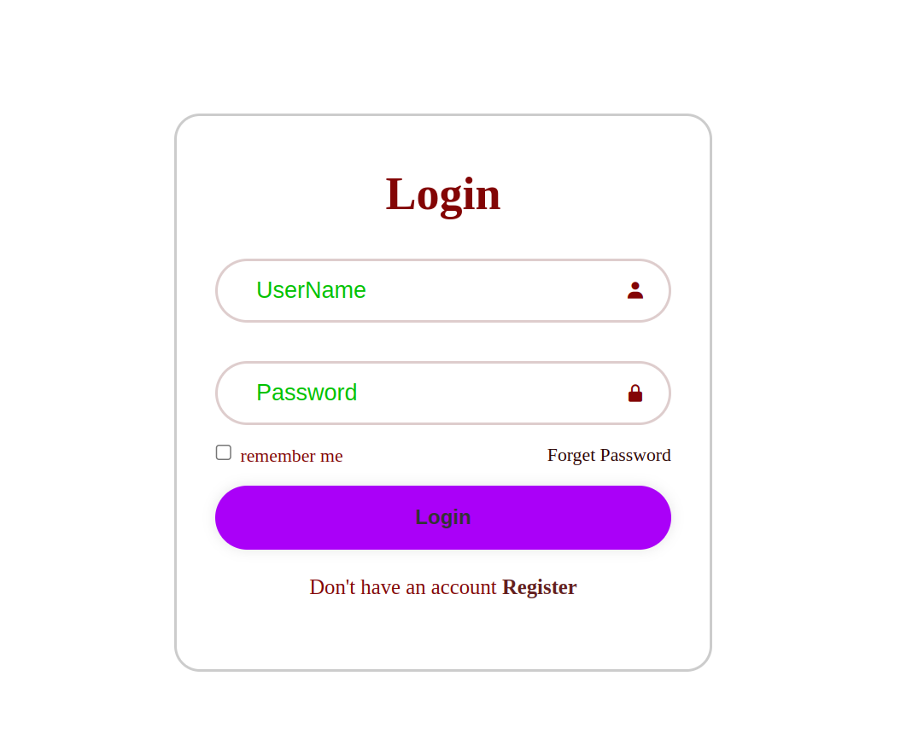
wrapper .register-link{
font-size:16.5px;
text-align: center;
margin: 20px 0 15px;
}
.register-link p a {
color:#641f1f;
text-decoration:none;
font-weight: 600;
}
.register-link p a:hover{
text-decoration: underline;
}
Now we finished almost the entire style we just need to adjust the colors and put the image

Slide 35
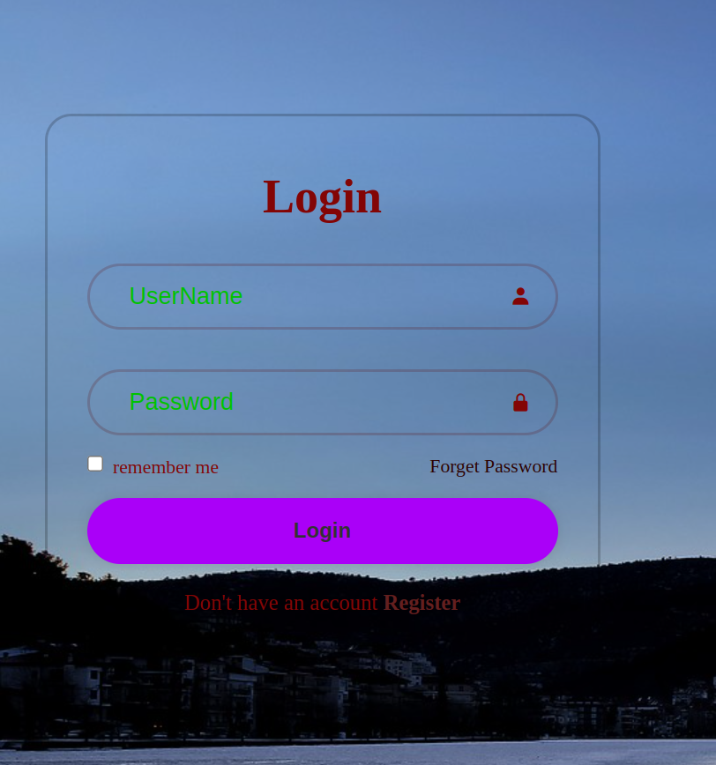
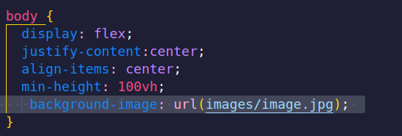
To put image add
background-image: url(images/image.jpg);
To the body
You can choose a background picture from here
https://pixabay.com/photos/frozen-lake-landscape-mountains-8496388/

Slide 36

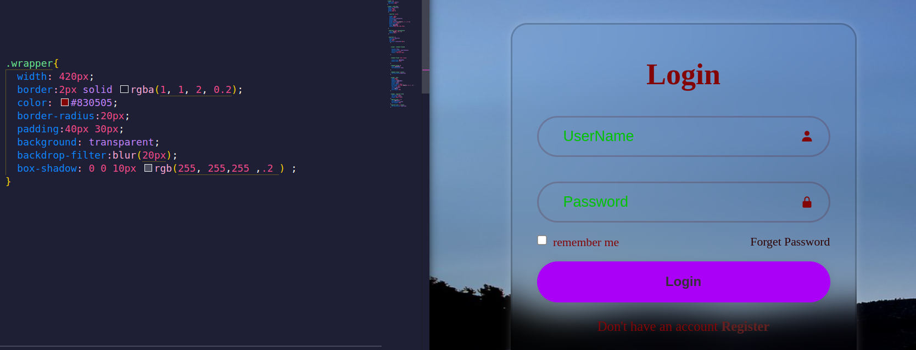
Let us add a box-shadow and a background to transparent
Also backdrop-filter to blur like that

Slide 37
Let's change the value of the following properties to get the final appearance
.wrapper {
border:2px solid rgb(255, 255,255 ,.2 );
color: #ffff;
box-shadow: 0 0 10px rgb(255, 255,255 ,.2 ) ;
}
.input-box input{
border:2px solid rgb(255, 255,255 ,.2 );
color: #ffff;
}
.input-box input::placeholder{
color: rgb(255,255,255);
}
.remember-forget label input{
accent-color: #ffff;
}
.remember-forget a{
color: #ffff;
}
.wrapper .btn
{
box-shadow: 0 0 10px rgba(0, 0, 0, .1) ;
color:#333;
}
Also remove background from .wrapper .btn
.register-link p a {
color:#ffff;
}

Slide 38
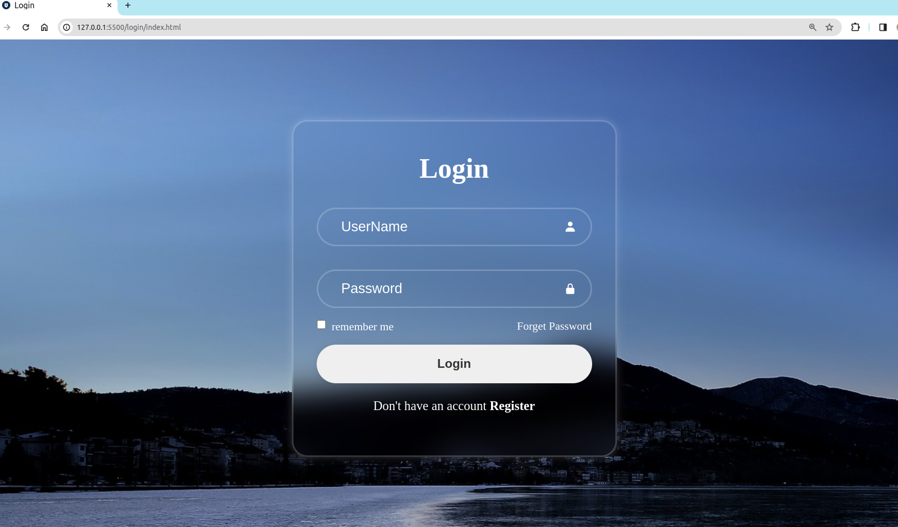
After making the previous changes we got our final web style as following

